Slide 1
Database Design Fundamentals
DV6E 34

Slide 2
Topics/Outline
Database – Definition, Types, Terminologies, concepts, classes & examples
Flat Files
Relational Database Management System (RDBMS)
E-R Data Model Systems
Normalisation
SQL – Introduction, queries,
Creating Database (simple - excel & structured - RDMS)
Basic Operations (DB interrogation, data acquisition, modification, normalisation, manipulation….)

Slide 3
Part. G: E-R Data Model (Entity Model Diagrams)

Slide 4
What is E-R Model? (Introduction)
The E-R (i.e. entity – relationship) model is a diagram designed to represent or show the relationship between the entities (and attributes) of database during design.
The model serves as an important feature which enables database architects and users to navigate through the framework of a given database and its process queries.
The E-R model diagram is usually setup by defining keys (primary & foreign keys) such that entities and attributes that are related can be linked through their keys.
It is good practise to setup the entity- relationship diagram prior to designing a database.

Slide 5
Data Modelling
E-R data modelling is a technique that is widely employed across different industries (IT, engineering design, business, etc.) to show how information is, or should be stored and used within a system.
The technique is aimed at creating an efficient way of storing, accessing, updating and using data in any organisation.
The technique provides a solid foundation for systems design and a universal standard used for process documentation.
The E-R model diagram generally serves as an essential precursor to analysis and design, maintenance and documentation, and for improving the performance of an existing system.
Note:
The effectiveness of process execution in any organization relies on the efficient flow and processing of information at every given tme.

Slide 6
Data Modelling – General Examples
University/College Example:
Tutor – Course relationship
Tutor – Course – Student relationship
Organisation – Company/Client Example:
Board of Directors – Manager relationship
Manager– Client relationship
Company/Staffs Case Study Example:
General manager – Staffs relationship
General manager – Department (sales, accounting,…) relationship
Accounts department – Sales relationship
Accounts department – Invoice relationship
Account department – Invoice – Sales – Customers relationship

Slide 7
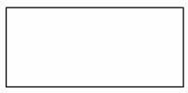

E-R Data Modelling Symbols
The E-R data model uses a set of standard symbols to represent the relationship that exist across all the entities and associated attributes in a given database system.
The model diagram consist of the following symbols:
A Box:
This is used to represent each entity in the model diagram
A connector/Line:
Usually called ‘crow’s foot’
Used to represent relationship between two or more entities
A relationship in the E-R model diagram represent the association between two entities to which all of the occurrences of those entities must conform.
The line represents two reciprocal relationships: that of the first entity with respect to the second, and that of the second with respect to the first.
Note:
The E-R model diagram is constructed by linking entities together that are related through their keys.

Slide 8
E-R Data Modelling – Relationship Types
There are three types of relationships commonly recognised to exist between entities within a model diagram.
They are;
One - One Relationship
One – Many Relationship
Many – Many Relationship

Slide 9

E-R Data Modelling – Relationship Types
One - One Relationship
This is the type of relationship represented when a single occurrence of an entity is related to just one occurrence of a second entity
Example: A roof covers a building, a building is covered by one roof
A diagram showing a one-to-one relationship connecting two related entities is shown below.

Slide 10

E-R Data Modelling – Relationship Types
One - Many Relationship
This is the type of relationship represented when a single occurrence of an entity is related to many occurrences of a second entity
Example: An employee works in one department of a company; a department in a company has many employees.
A one-to-many relationship is represented by a line connecting two entities with a ‘crow’s foot’ symbol (i.e. line) symbol which denotes the ‘many’ end of the relationship diagram.

Slide 11

E-R Data Modelling – Relationship Types
Many- Many Relationship
This is the type of relationship represented when multiple occurrences of an entity are related to multiple occurrences of a second entity
Example: Many employees in an organisation can be involved in many projects at a given time.
A many-to-many relationship is represented by a line connecting two entities with a ‘crow’s foot’ symbol (i.e. line) at both ends of the relationship diagram.

Slide 12
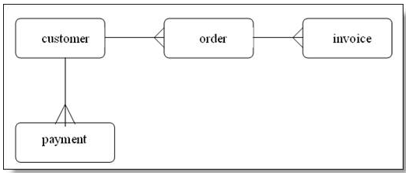
E-R Data Modelling – Examples
Example 1: Information flow across various departments of an organisation
This information can take many forms; for example it could be written, oral or electronic.
The General Manager regularly communicates with staff in the sales and marketing and accounts departments by using email
Orders received by sales and marketing are forwarded to the production and accounts departments for processing and invoicing.
The accounts department forwards regular written reports to the General Manager. It also raises invoices and sends these to the customers.

Slide 13
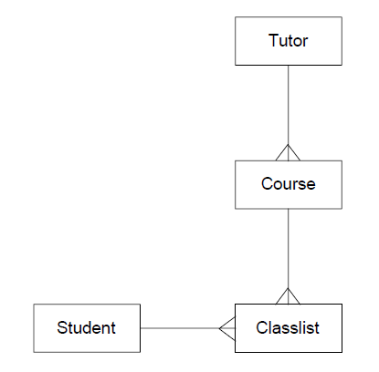
E-R Data Modelling – Examples
Example 2: College Tutor’s list of courses and students
From the E-R data model above, we can make several statements as follows:
A Tutor teaches many Courses
A Student appears on many Classlists
The Course entity contains the key of Tutor
The Classlists entity contains the keys of Student and Course
A Course contains a Classlist

Slide 14
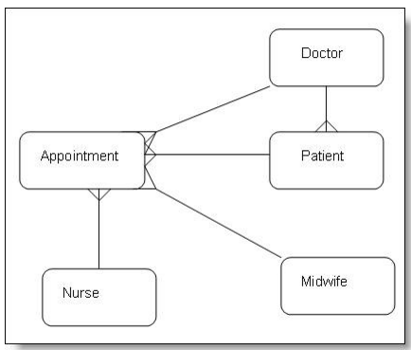
E-R Data Modelling – Examples
Example 3: Study the following information given and attempt to draw the entity model
that matches it.
Question
Mosspark Surgery has doctors, nurses, midwives and patients. The patient has to telephone for appointments with the doctors or nurses and these appointments are allocated by the receptionist. An appointment can only be made with one doctor, midwife or nurse at a time. A patient can also register with only one doctor.
Solution

